Slide 1
Product Backlog
Team project
Jack Tyas (A00243269): 20%
Arkadiusz zajac (a00239510): 20%
Bin Huang(A00277354): 20%
Zixuan Huang(A00268943): 20%
Ashutosh Mishra(A00268734) :20%

Slide 2
User stories
Created on easybacklog.com
Objective: To complete user stories to develop an application for the customer (Newsagent) based on given criteria.
These user stories are created to aid the sprints that the group will undertake in semester 2.

Slide 3
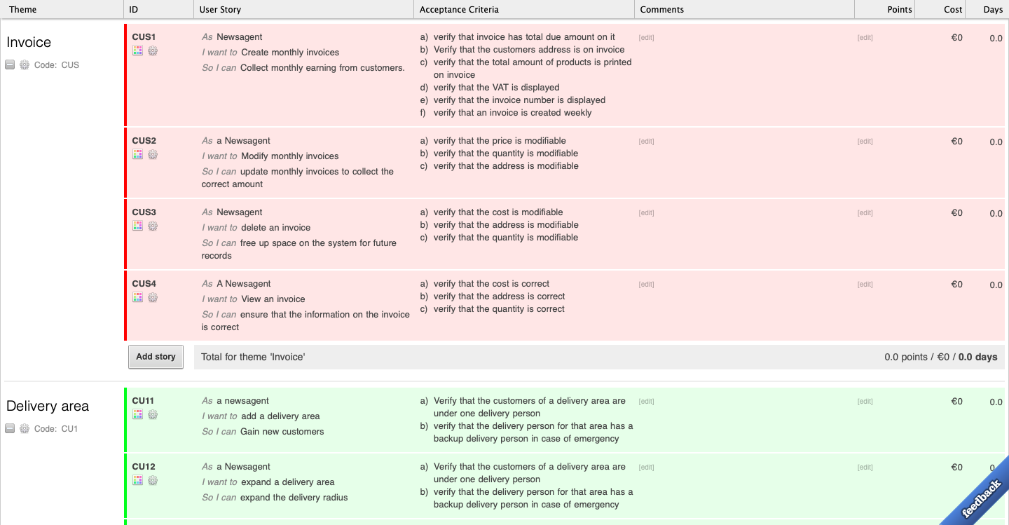

Slide 4
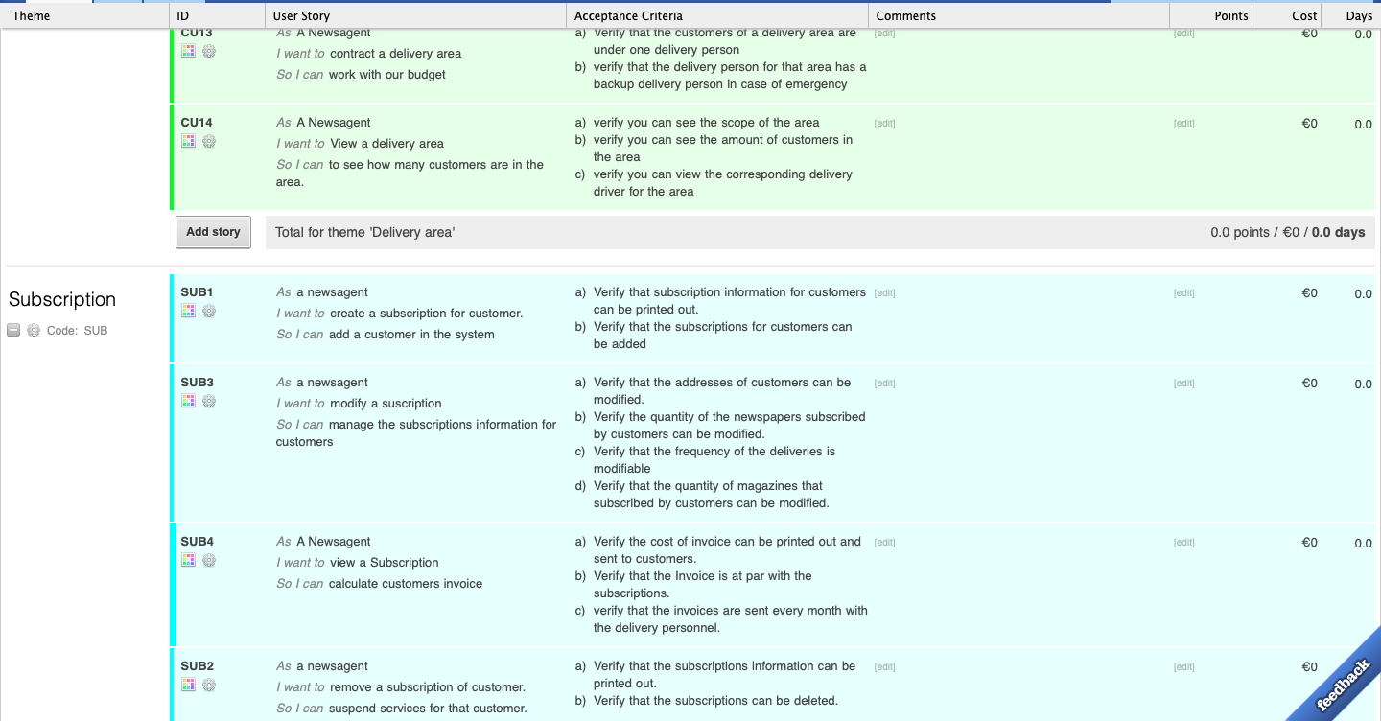

Slide 5
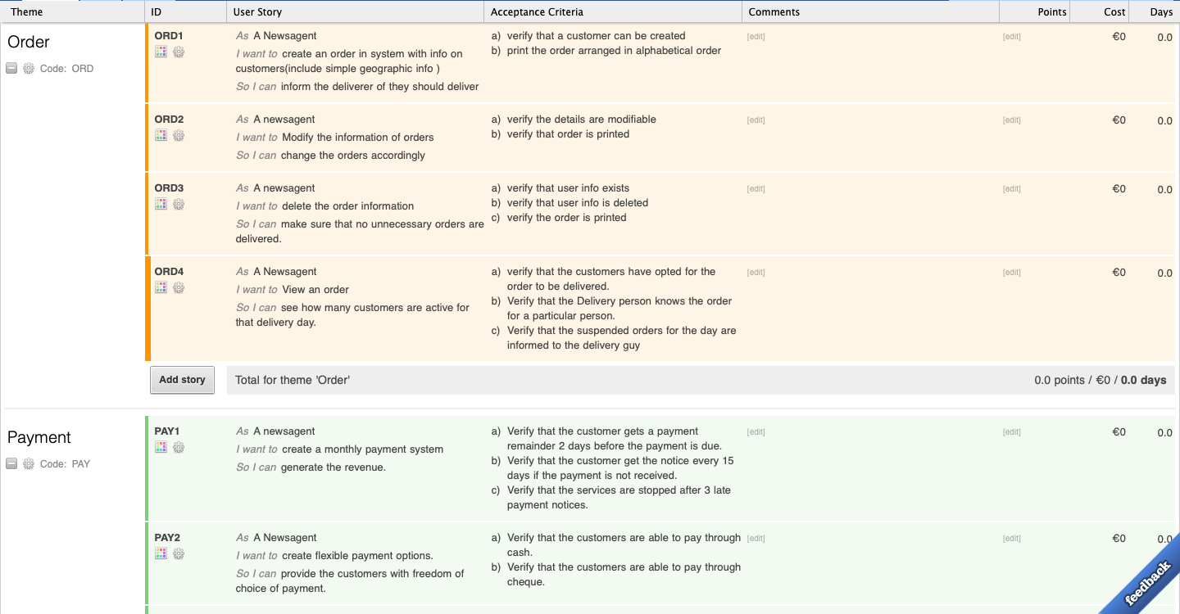

Slide 6
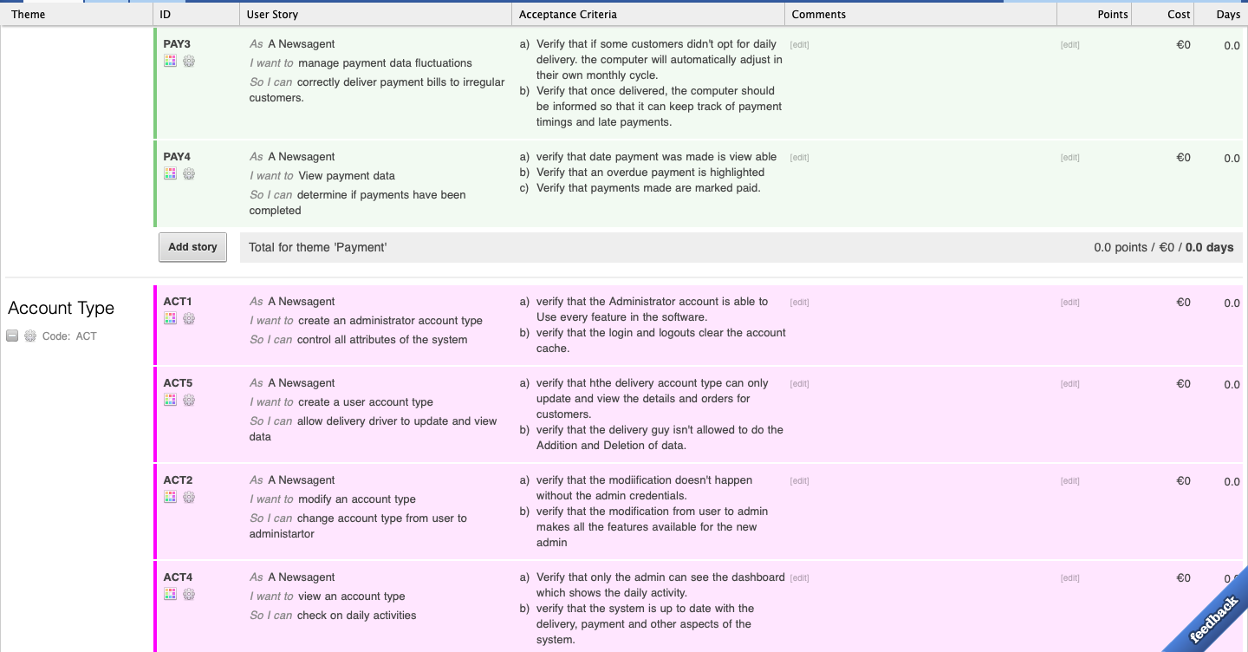

Slide 7
